Slide 1





Samsung Ex-link
RS-232 Control
Scott Whitman Product Support Manager, SEA

Slide 2
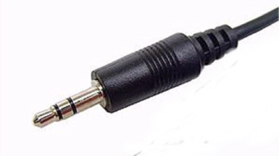

Samsung TV’s can be controlled via RS232 by connecting to the Ex-Link port (Note: if the TV does not have an Ex-Link port, it does not support RS232).
The Ex-Link port is a 3.5mm 3 point connection.
Although there is both a Tx and Rx line, control data can only be sent to the TV through 2011 product. There is no support for status.
The following work book outlines the structure of the Samsung coding, connector pin-out for Ex-Link, testing application and a copy of supported coding.

Slide 3
Byte1 | Byte2 | Byte3 | Byte4 | Byte5 | Byte6 | Byte7
0x08 | 0x22 | Cmd1 | Cmd2 | Cmd3 | Value | CS
Do not change Byte 1 and Byte 2 as they are fixed value
Bytes 3 through 6 are the command bytes (see slides 4 through 7)
Byte 7 (check sum) is the two’s complement of Byte 1 through 6 (see slide 3)
Example:
Byte 3 = ‘0x4’ Channel Direct Tuning:
Byte 4 = selects between DTV and ATV (select ‘0080’ for DTV)
Byte 5 = major channel in DTV multiplied by 4
(i.e. if major channel is 4, Byte 5 = 4 * 4 = 16 = 10 in hex. Byte = ‘0x10’)
Byte 6 = minor channel (i.e. channel 4-2 Byte 6 = ‘0x2’)
Example: To direct tune Channel 4-2:
The 7 byte structure would be:
0x8 0x22 0x4 0x80 0x10 0x2 0x40

Slide 4
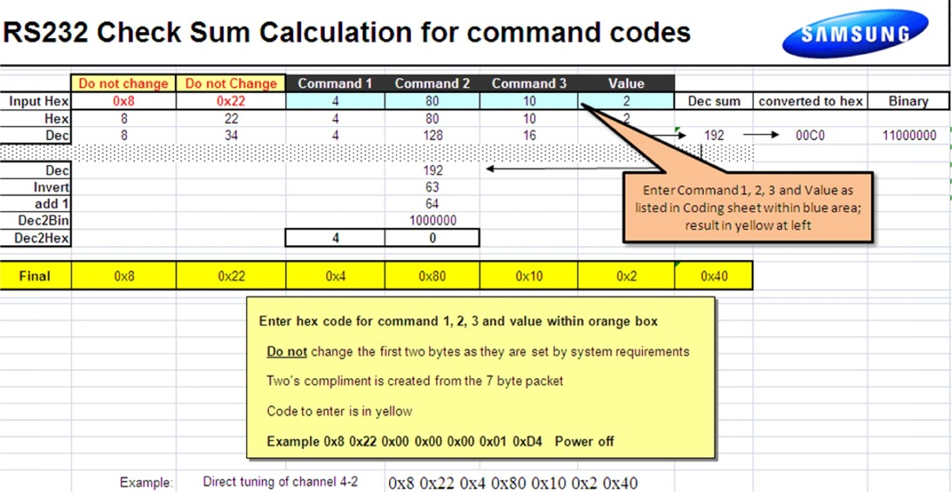


Slide 5
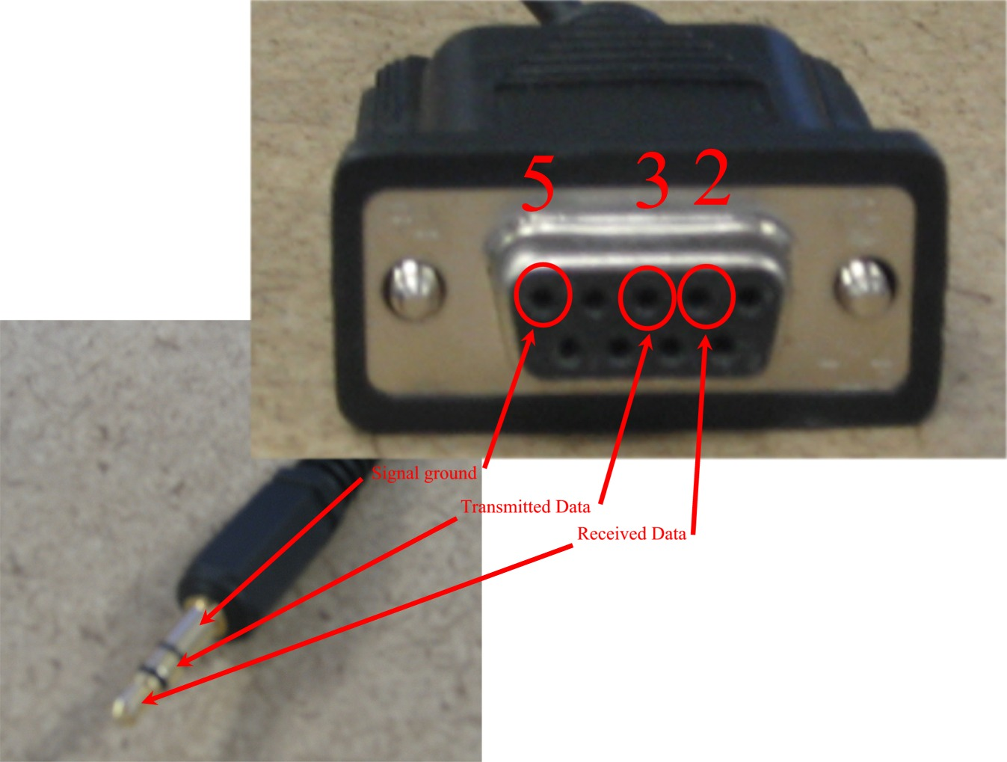
Ex-Link cable pin out
Part number: AA39-00311A
Available through GPCA or Samsungparts.com

Slide 6
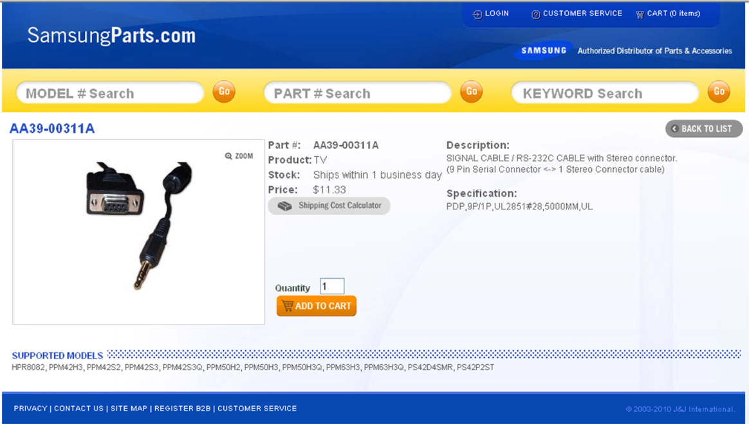
SamsungParts.com

Slide 7
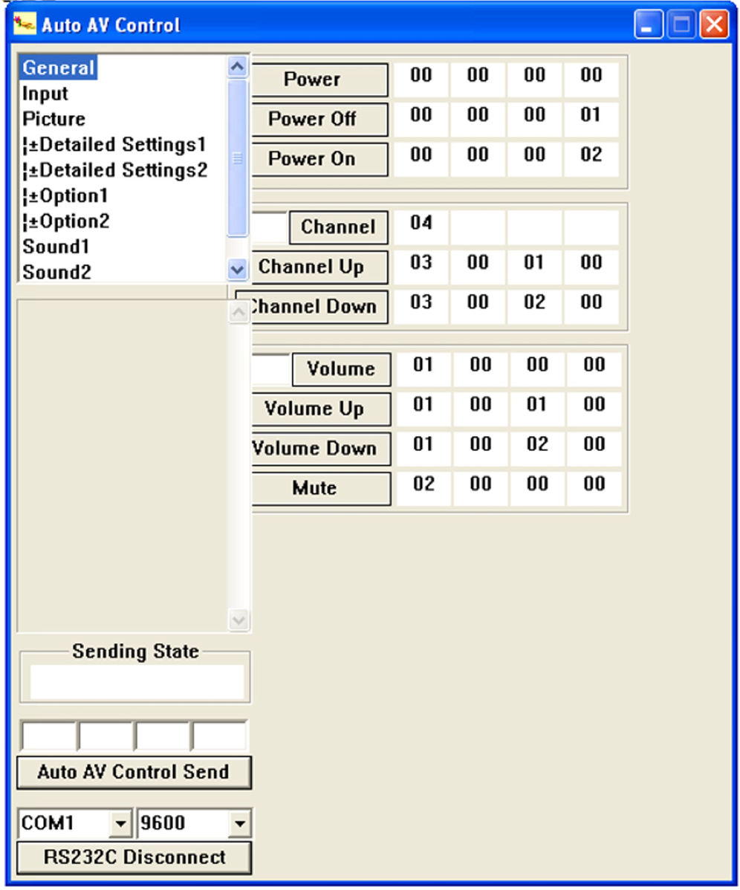
Ex-Link test app
2009 and prior
Basic operation can be verified using this application.
All basic operations can be verified by simple key press.
Selecting “Power On” should generate the code (byte 3 thru 6) and send it to the TV via the Ex-Link port.
In the “Sending State” window, the status of code will be displayed.
Once the TV accepts the code, “success” should be displayed in the window

Slide 8
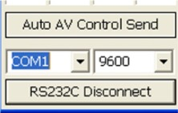
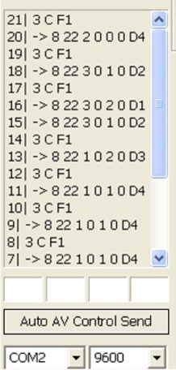
Communication settings:
Baud rate: 9600
Set com port to match your PC
Once com port selected, click on the RS232C Connect button
Once connected
As you select the functions within the app, the window will display both the sending 7 byte command as well as show whether the TV acknowledged the command.
Ex. Line 15, no “3CF1” acknowledge return

Slide 9

Model list:

Slide 10
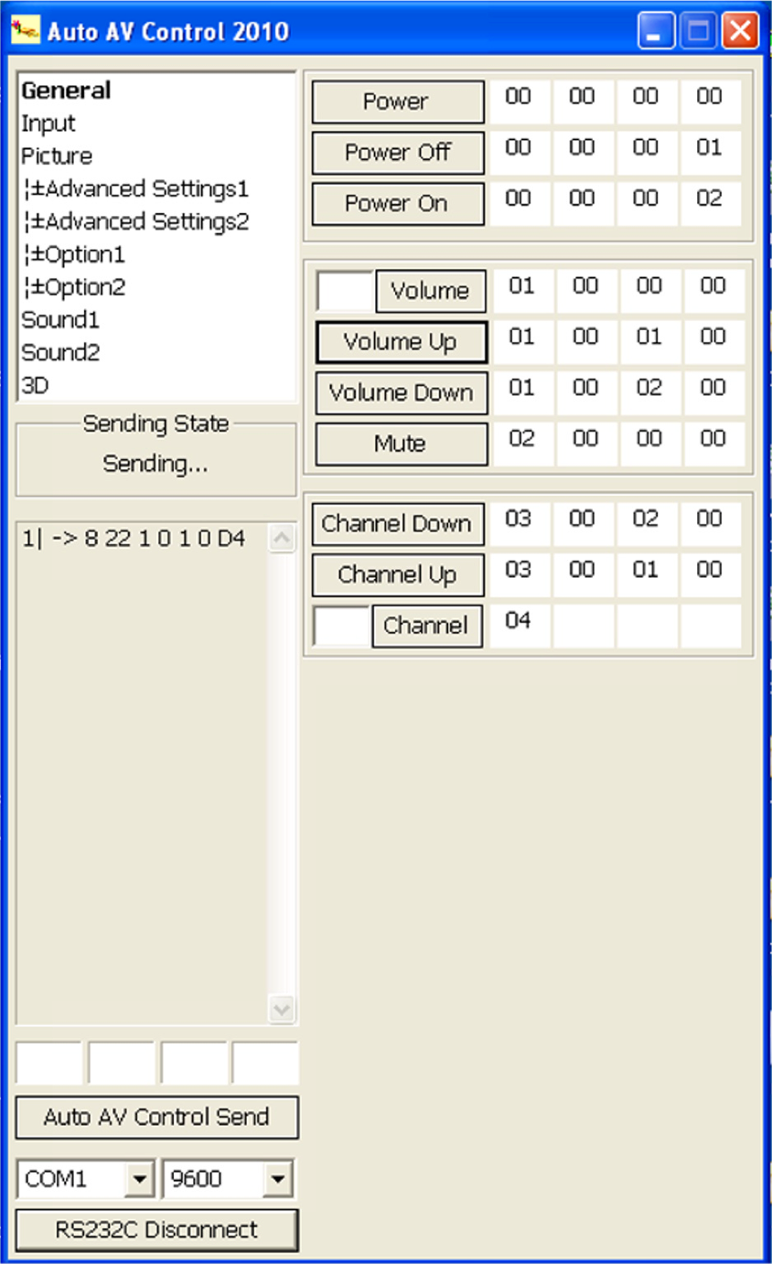
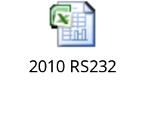


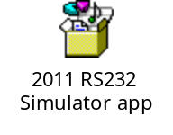


Ex-Link test app and RS232 coding for 2010/2011/2012/2013
Embedded files
Basic operation can be verified using this application.
All basic operations can be verified by simple key press.
Selecting “Volume Up” should generate the code (byte 3 thru 6) and send it to the TV via the Ex-Link port.
In the “Sending State” window, the status of code will be displayed.
Once the TV accepts the code, “success” should be displayed in the window

Slide 11
End
Scott Whitman Product Support Manager, SEA

